Slide 1
History of Soil

Slide 2
The Soil Profile

Slide 3
Think back: What are the three ways soils can form?
Chemical processes
Physical processes
Biological processes

Slide 4
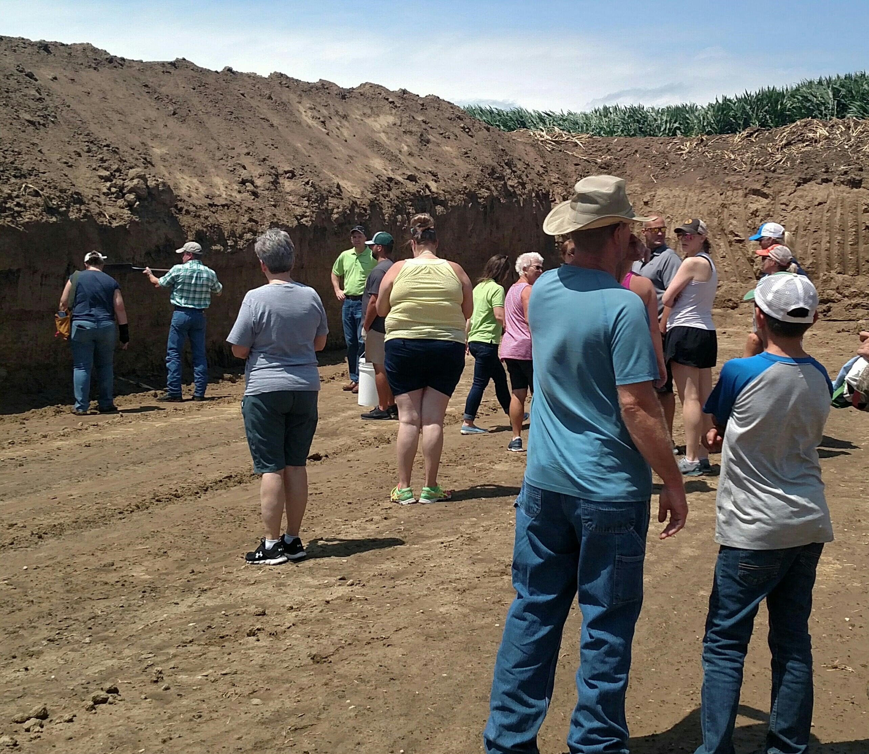
Soil Forming Factors: CLORPT
Climate
Organisms
Relief
Parent Material
Time

Slide 5
Climate
Climate consists of weather patterns over time
Temperature, precipitation, and more are included in climate
Rainfall impacts how minerals leach through the soil profile
Temperature impacts microbial activity
Freeze/thaw actions impact soil structure

Slide 6
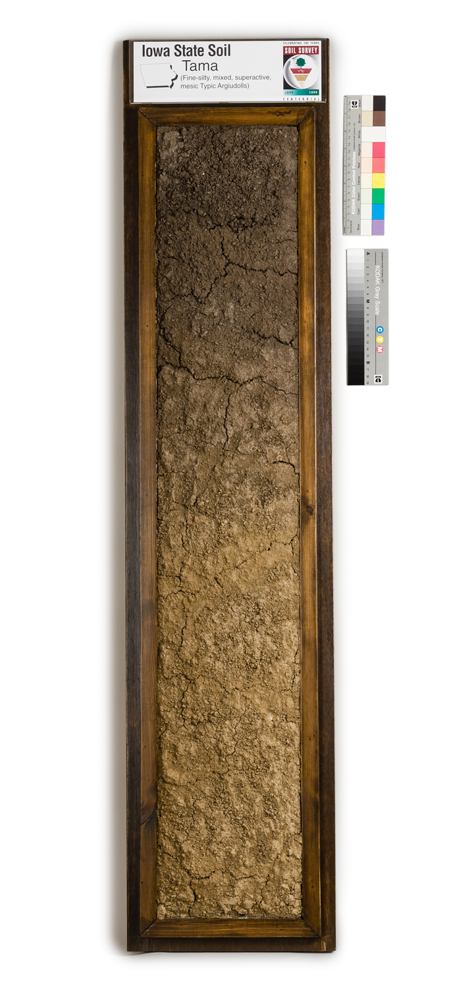
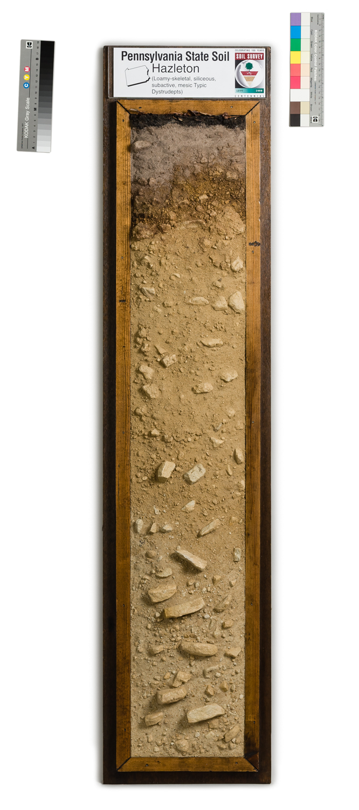
Organisms
The native vegetation of an area impacts soil formation
Soils formed from native grasslands have lots of organic matter
Soils formed from native forests are shallower, and often create different colored soils

Slide 7
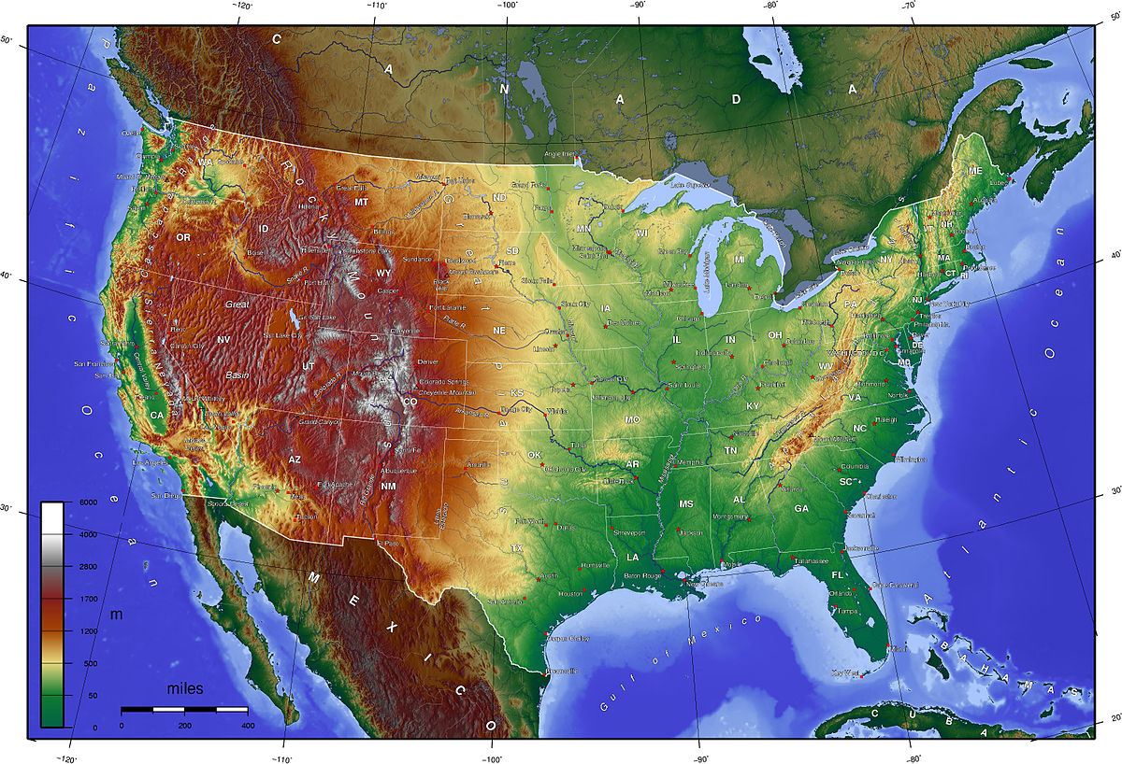
Relief
The topography of land impacts how it is weathered
Where hills exist, erosion makes them steeper
Flat lands may hold water more
This Photo by Unknown Author is licensed under CC BY-SA

Slide 8
Parent Material
Parent material is what the soil formed from (C horizon)
Iowa’s main parent materials are:
Loess
Windblown sediment
Glacial till
Sediment moved in by glaciers
Alluvium
Sediment deposited by a river during flooding (water moving upwards)
Colluvium
Sediment deposited by a weather event from a higher landform (water moving downwards)

Slide 9
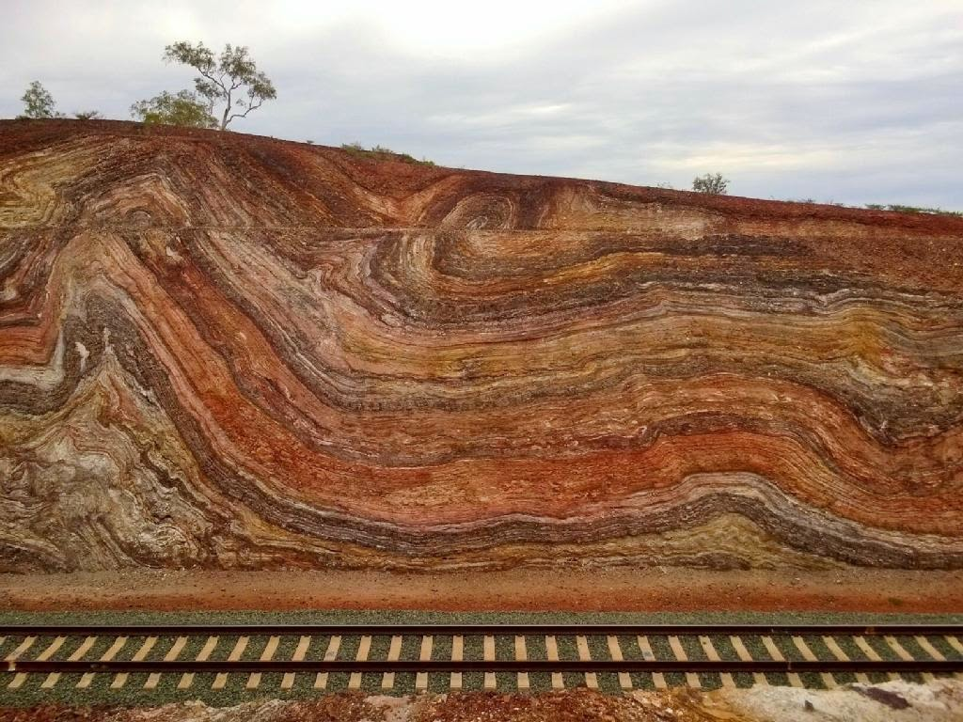
Time
All soils weather over time
Natural process over time can create soils and destroy soils
Old soils are heavily weathered
Minerals and sediment have leached through the soil profile
More horizons and more distinct horizons have formed
Young soils may still be forming
Soils are shallower
Fewer horizons have formed
This Photo by Unknown Author is licensed under CC BY

Slide 10
What are Iowa’s Soil Forming Factors?
Climate:
Humid continental, hot summers, cold winners, 26-38” precipitation each year
Organisms:
Native prairie, grassland biome
Relief:
Most acres are 0-5% slope
Parent material:
Loess, till, alluvium
Time:
Cultivation during the last 160 years has reduced organic matter content and accelerated erosion

Slide 11
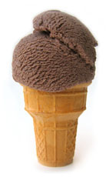
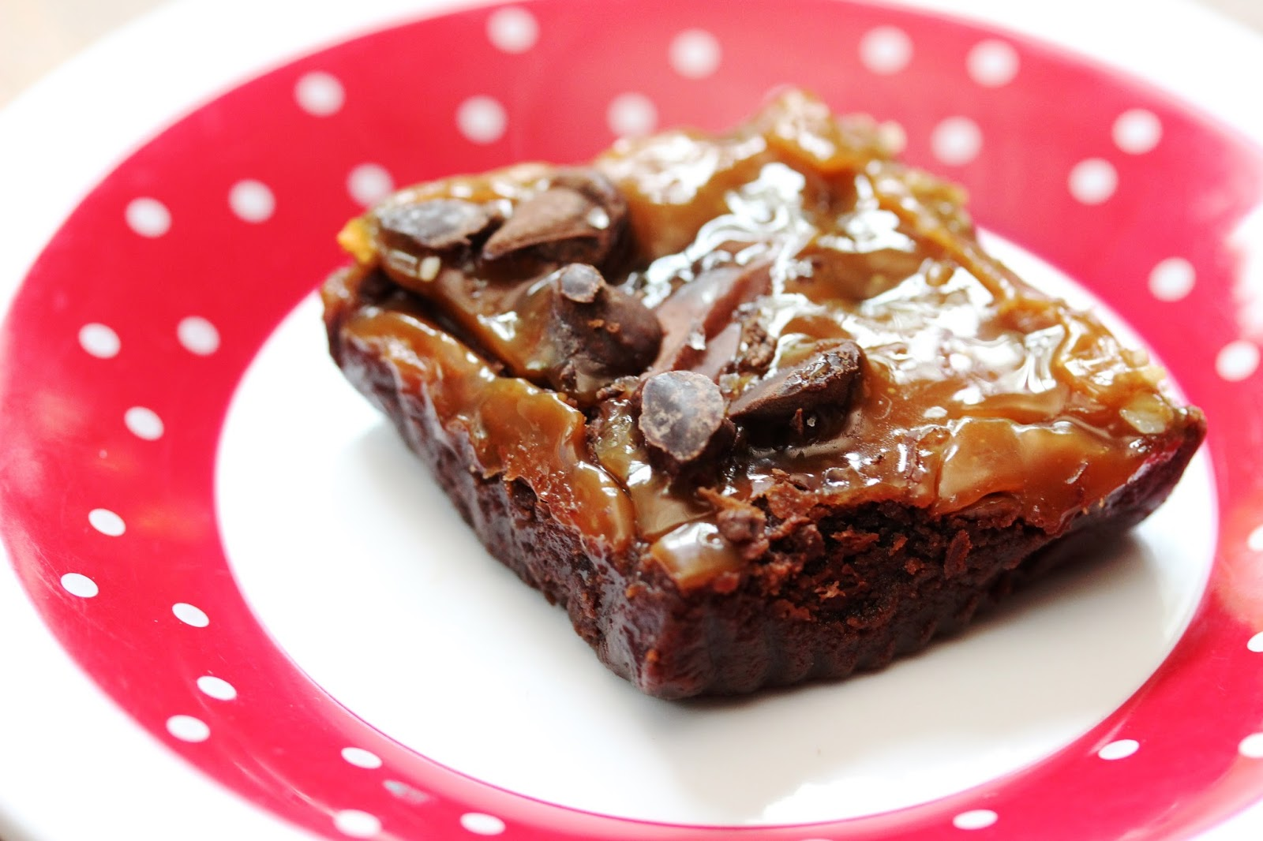
Brownie Glaciation

Slide 12
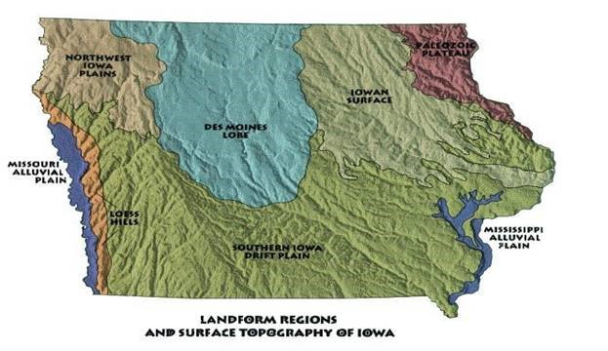
Journal Prompts:
What are your observations from the brownie glaciation activity?
How would glaciation impact living organisms?
What does this tell you about Iowa’s soil formation?

